Slide 1
Computer Organization Principles
School of Software, Dalian University of Technology
Chi Lin (林驰)
chilin@mail.dlut.edu.cn

Slide 2
Chapter Four: Instruction Systems
Instruction Encoding (指令编码)
Addressing Modes and Formats(寻址方式)
Instruction Usage (指令使用方法)
RISC

Slide 3
About this course
Computer Instruction Addressing
X86 Instruction Addressing

Slide 4
Instruction Format
The instruction format defines the layout fields in the instruction. Instruction format design is a complex undertaking, including such consideration as:
instruction length
fixed or variable length,
number of bits assigned to opcode and each operand reference,
how addressing mode is determined.

Slide 5
Addressing Modes and Formats
Immediate Addressing
Direct Addressing
Indirect Addressing
Register Addressing
Register Indirect Addressing
Displacement Addressing
Stack Addressing

Slide 6
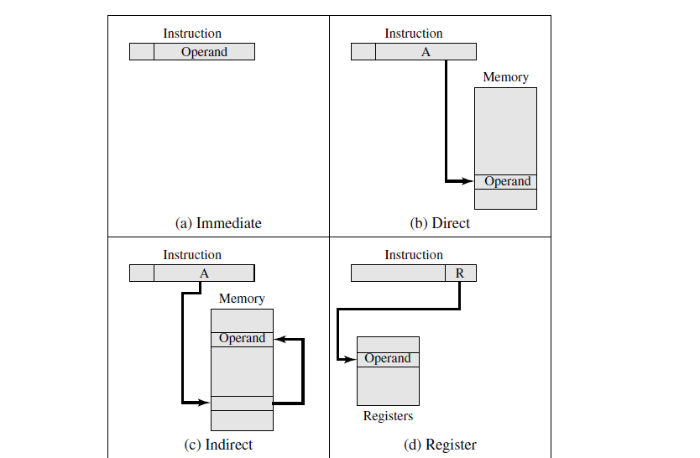
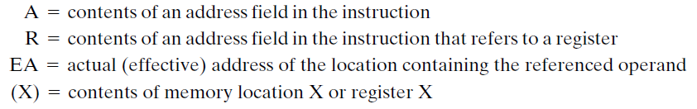
Addressing Modes I

Slide 7
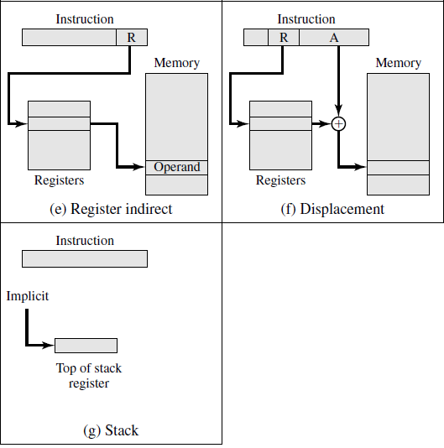
Addressing Modes II

Slide 8
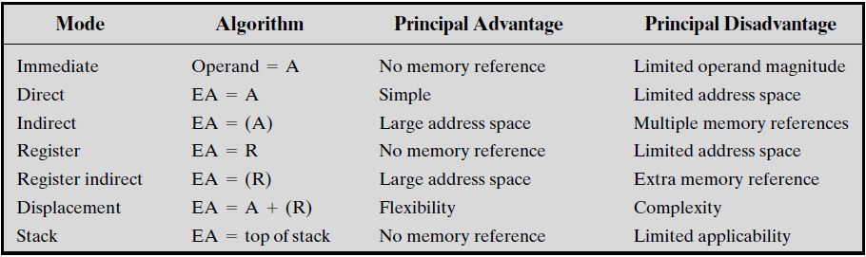
Details of each addressing mode

Slide 9
Two concerns I
The First Concern: How to distinguish 如何区分寻址方式?
All computer architectures provide more than one of these addressing modes. Different opcodes will use different addressing modes. One or more bits in the instruction format can be used as a mode field. The value of the mode field determines which addressing mode is to be used.

Slide 10
Two concerns II
The Second Concern: How to map ?
In a system without virtual memory, the effective address will be either a main memory address or a register. In a virtual memory system, the effective address is a virtual address or a register. The actual mapping to a physical address is a function of the memory management unit (MMU) and is invisible to the programmer.

Slide 11
Immediate Addressing (立即数寻址)
The simplest form of addressing is immediate addressing, in which the operand value is presented in the instruction.
Operand = A
This mode can be used to define and use constants or set initial values of variables.
E.g. movl $0x4050, %eax
Advantages: save one memory or cache cycle in the instruction cycle
Disadvantages: size of the number is restricted to the size of the address field

Slide 12
Immediate Addressing (立即数寻址)
Immediate Addressing
OP
#
A
Immediate
Two’s Comp

Slide 13
Direct Addressing (直接寻址)
A very simple form of addressing is direct addressing, in which the address field contains the effective address of the operand:
EA = A
The technique was common in earlier generations of computers but is not common on contemporary architectures.
Advantages: it requires only one memory reference and no special calculation.
Disadvantages: it provides only a limited address space.

Slide 14
Direct Addressing (直接寻址)
Addressing Feature
Memory
LDA
A
A
Operand
ACC
EA = A

Slide 15
Indirect Addressing (间接寻址)
With direct addressing, the length of the address field is usually less than the word length, thus limiting the address range. One solution is to have the address field refer to the address of a word in memory, which in turn contains a full-length address of the operand. This is known as indirect addressing

Slide 16
Indirect Addressing (间接寻址)
EA = (A)
Advantages: for a word length of N, an address space of is now available.
Disadvantage: instruction execution requires two memory references to fetch the operand: one to get its address and a second to get its value.

Slide 17
Indirect Addressing
Addressing Feature
Memory
Multiple Memory Access
OP
A
A
EA
Addressing Feature
Memory
Addressing
EA
Operand
OP
A
A
A₁
1
EA =（A）
Multiple Addressing
EA
A₁
0
EA
Operand

Slide 18
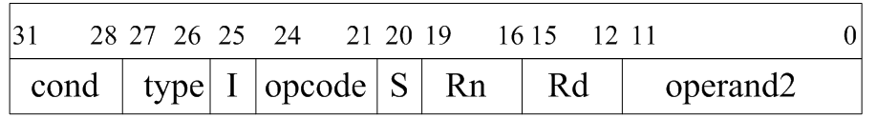
Register Addressing (寄存器寻址)
Register addressing is similar to direct addressing. The only difference is that the address field refers to a register rather than a main memory address:
EA = R
Typically, an address field that references registers will have from 3 to 5 bits, so that a total of from 8 to 32 general-purpose registers can be referenced.
E.g. ARM Instruction

Slide 19
Register Addressing (寄存器寻址)
The advantages of register addressing are that (1) only a small address field is needed in the instruction, and (2) no time-consuming memory references are required.
The disadvantage of register addressing is that the address space is very limited.
E.g. add $4,%esp

Slide 20
Register Addressing (寄存器寻址)
OP
R_{i}
R₀
…
…
R_{i}
Operand
…
R_{n}
…
Registers

Slide 21
Register Indirect Addressing (寄存器间接寻址)
Register indirect addressing is analogous to indirect addressing. The only difference is whether the address field refers to a memory location or a register. Thus, for register indirect address,
EA = (R)
Advantages: the address space of the address field is overcome by having that field refer to a wordlength location containing an address. In addition, register indirect addressing uses one less memory reference than indirect addressing.
Disadvantages: One register reference, one memory reference.
E.g. movl %ebp,(%esp)

Slide 22
Register Indirect Addressing (寄存器间接寻址)
Addressing Feature
OP
R_{i}
Memory
R₀
…
…
R_{i}
Address
Operand
…
R_{n}
…
Registers

Slide 23
Displacement Addressing(偏移寻址)
A very powerful mode of addressing combines the capabilities of direct addressing and register indirect addressing. It is known by a variety of names depending on the context of its use, but the basic mechanism is the same. We will refer to this as displacement addressing:
EA = A + (R)
Relative Addressing (相对寻址)
Base-Register Addressing (基址寄存器寻址)
Indexing Addressing (变址寻址)

Slide 24
Relative Addressing (相对寻址)
For relative addressing, also called PC-relative addressing, the implicitly referenced register is the program counter (PC). That is, the next instruction address is added to the address field to produce the EA. Typically, the address field is treated as a twos complement number for this operation. Thus, the effective address is a displacement relative to the address of the instruction.

Slide 25
Base-Register Addressing (基址寄存器寻址)
For base-register addressing, the interpretation is the following: The referenced register contains a main memory address, and the address field contains a displacement (usually an unsigned integer representation) from that address. The register reference may be explicit or implicit.

Slide 26
Indexing Addressing (变址寻址)
For indexing, the interpretation is typically the following: The address field references a main memory address, and the referenced register contains a positive displacement from that address.

Slide 27
Stack Addressing (堆栈寻址)
It is sometimes referred to as a pushdown list or last-in-first-out queue.
Associated with the stack is a pointer whose value is the address of the top of the stack. Alternatively, the top two elements of the stack may be in processor registers, in which case the stack pointer references the third element of the stack.
The stack pointer is maintained in a register. Thus, references to stack locations in memory are in fact register indirect addresses.

Slide 28
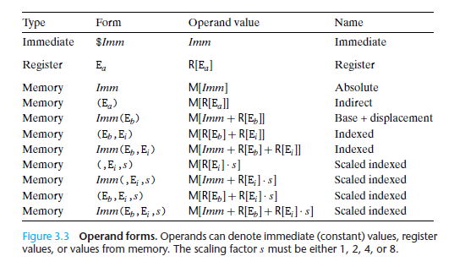
Addressing Categories (X86)

Slide 29
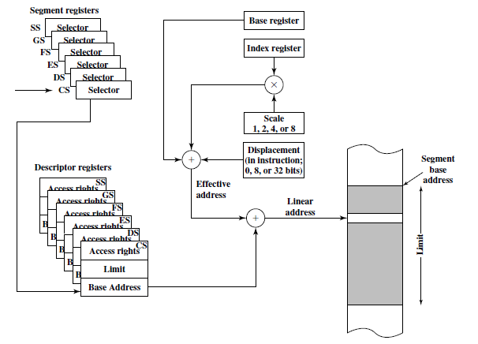
X86 Addressing Mode Calculation

Slide 30
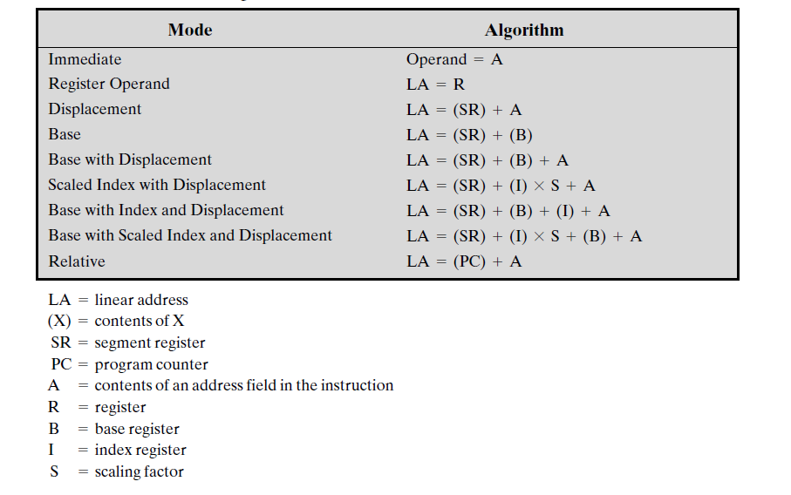
X86 Addressing

Slide 31
Machine Level Language
IA32 machine code differs greatly from the original C code. Parts of the processor state are visible that normally are hidden from the C programmer:
The program counter (commonly referred to as the “PC,” and called %eip in IA32) indicates the address in memory of the next instruction to be executed.

Slide 32
Machine Level Language
The integer register file contains eight named locations storing 32-bit values. These registers can hold addresses (corresponding to C pointers) or integer data. Some registers are used to keep track of critical parts of the program state, while others are used to hold temporary data, such as the local variables of a procedure, and the value to be returned by a function.

Slide 33
Machine Level Language
The condition code registers hold status information about the most recently executed arithmetic or logical instruction. These are used to implement conditional changes in the control or data flow, such as is required to implement if and while statements.
A set of floating-point registers store floating-point data.

Slide 34
How to design the instruction set ?
Instruction Length
Allocation of Bits
Number of addressing modes
Number of operands
Register vs. memory
Number of register sets
Address range
Address granularity

Slide 35
Instruction Set Example (ARM)
cond（bit[31:28]） 指令执行的条件码
type（bit[27:26]） 指令类型码
opcode（bit[24:21]） 指令操作码；
S （bit[20]） 决定指令的操作结果是否影响CPSR ；
Rn （bit[19:16]） 包含第一个操作数的寄存器编码；
Rd （bit[15:12]） 目标寄存器编码；
Operand2（bit[11:0） 指令第二个操作数。

Slide 36
Huffman Encoding (霍夫曼编码)
The Huffman encoding algorithm is an optimal compression algorithm when only the frequency of individual instructions are obtained.
The idea behind the algorithm is that if you have some instructions that are more frequent than others, it makes sense to use fewer bits to encode those instructions than to encode the less frequent instructions.

Slide 37
Huffman Encoding: An Example

Slide 38
Thank You

